Slide 1


Exposure Java 2015
AP®CS Edition
Chapter 8 Slides
Manipulating Strings
PowerPoint Presentation
created by:
Mr. John L. M. Schram
and Mr. Leon Schram
Authors of Exposure Java

Slide 2
Section 8.1
Introduction to
String Methods

Slide 3
String Processing
Word processing term papers, writing memoirs, sending email messages, responding to surveys, placing online orders and registering products all involve string processing.
Every software package on the market includes string-processing components.
Every programming language has special features that facilitate the manipulation of strings, and Java is no different.

Slide 4
String Definition
A String is a set of characters that behaves as a single unit.
The characters in a String include upper-case and lower-case letters, numerical characters and a large set of characters for a variety of purposes like:
! @ # $ % ^ & * ( ) _ +

Slide 5
String Variables vs. String Literals
A string literal is a set of characters delimited with double quotations.
String name = “John Smith”;
name is the string variable.
“John Smith” is the string literal.

Slide 6
Section 8.2
Constructing
String Objects

Slide 7
Is String a Simple Data Type?
When you see statements like:
which looks very similar to
you might get the idea that String is a simple
(or primitive) data type like int, double, char, and boolean. However, String is NOT a simple data type. String is a class.
String name = “John”;
int x = 5;

Slide 8
// Java0801.java
// This program demonstrates multiple ways to construct String objects.
// Note that all four string objects store the same information.
public class Java0801
{
public static void main (String args[])
{
String s1 = "Tango";
System.out.println("s1: " + s1);
String s2 = new String();
s2 = "Tango";
System.out.println("s2: " + s2);
String s3 = new String("Tango");
System.out.println("s3: " + s3);
String s4 = new String(s3);
System.out.println("s4: " + s4);
}
}
s1: Tango
s2: Tango
s3: Tango
s4: Tango

Slide 9
Section 8.3
String
Method
length

Slide 10
// Java0802.java
// This program demonstrates the use of the <length> method.
// It also reviews string concatenation with the < + > operator.
public class Java0802
{
public static void main (String args[])
{
String s1 = "Argentine";
String s2 = "Tango";
String s3 = s1 + " " + s2;
System.out.println(s1 + " has " + s1.length() + " characters.");
System.out.println(s2 + " has " + s2.length() + " characters.");
System.out.println(s3 + " has " + s3.length() + " characters.");
System.out.println();
}
}
Argentine has 9 characters.
Tango has 5 characters.
Argentine Tango has 15 characters.

Slide 11
String Method length
int count = str.length();
Method length returns the length or number of characters in the String object.
If str equals "Aardvark" then count becomes 8.

Slide 12
Section 8.4
Working with
Substrings

Slide 13
// Java0803.java
// This program demonstrates how to access specified characters of a string
// with the <substring(SI,EI)> method, where SI is the Starting Index and
// EI is one more than the Ending Index.
public class Java0803
{
public static void main (String args[])
{
String s = "Racecar";
System.out.println(s.substring(0,4));
System.out.println(s.substring(1,4));
System.out.println(s.substring(2,4));
System.out.println(s.substring(2,6));
System.out.println(s.substring(3,6));
System.out.println(s.substring(4,7));
System.out.println();
}
}
0 | 1 | 2 | 3 | 4 | 5 | 6
R | a | c | e | c | a | r
Race
ace
ce
ceca
eca
car

Slide 14
String Method substring
s1 = “Aardvark”;
s2 = s1.substring(j,k);
Method substring returns a set of consecutive characters from string s1, starting at index j, and ending at index k-1.
s3 = s1.substring(4,7);
s3 becomes "var"
s1 | 0 | 1 | 2 | 3 | 4 | 5 | 6 | 7
 | A | a | r | d | v | a | r | k

Slide 15

Important Note
The first index of a String is always 0.
s1 | 0 | 1 | 2 | 3 | 4 | 5 | 6 | 7
 | A | a | r | d | v | a | r | k

Slide 16
// Java0804.java
// This program compares the two <substring> methods.
// Java can tell the difference, because of the different parameter signatures.
public class Java0804
{
public static void main (String args[])
{
String s = "Racecar";
int n = s.length();
for (int k = 0; k < n; k++)
System.out.println(s.substring(k));
System.out.println();
for (int k = 0; k < n; k++)
System.out.println(s.substring(k,n));
System.out.println();
}
}
Racecar
acecar
cecar
ecar
car
ar
r
Racecar
acecar
cecar
ecar
car
ar
r
0 | 1 | 2 | 3 | 4 | 5 | 6
R | a | c | e | c | a | r

Slide 17
Overloaded String Method substring
s1 = “Aardvark”;
s2 = s1.substring(j);
Method substring returns a set of consecutive characters from String s1, starting at index j,
and continuing all the way to the end of the string.
s3 = s1.substring(4);
s3 becomes "vark"
s1 | 0 | 1 | 2 | 3 | 4 | 5 | 6 | 7
 | A | a | r | d | v | a | r | k

Slide 18
// Java0805.java
// This program shows the <indexOf> method, which returns the index of the first
// occurrence of the string argument or -1 if the string is not found.
public class Java0805
{
public static void main (String args[])
{
String s1 = "racecar";
String s2 = "racecar in the carport";
String s3 = "car";
int index1 = s1.indexOf(s3);
int index2 = s2.indexOf(s3);
int index3 = s3.indexOf("qwerty");
System.out.println("With \"" + s1 + "\" car starts at " + index1);
System.out.println("With \"" + s2 + "\" car starts at " + index2);
System.out.println("With \"" + s3 + "\" Qwerty shows up at " + index3);
System.out.println();
}
}
With "racecar" car starts at 4
With "racecar in the carport" car starts at 4
With "car" Qwerty shows up at -1

Slide 19


String Method indexOf
indexOf returns the first occurrence
of a substring.
s1.indexOf(“hum”); returns 0
s1.indexOf(“ku”); returns 10
s1.indexOf(“qwerty”); returns -1
If the substring cannot be found
a value of -1 is returned.
s1 | 0 | 1 | 2 | 3 | 4 | 5 | 6 | 7 | 8 | 9 | 10 | 11 | 12 | 13 | 14 | 15 | 16 | 17 | 18 | 19 | 20 | 21
 | h | u | m | u | h | u | m | u | n | u | k | u | n | u | k | u | a | p | u | a | ’ | a
By the way,
it is the State Fish of Hawaii.

Slide 20
// Java0806.java
// There is a an overloaded <indexOf> method, which uses a
// second parameter to indicate the start of the search
public class Java0806
{
public static void main (String args[])
{
String str = "Mississippi is a state and it is a river.";
System.out.println(str.indexOf("is"));
System.out.println(str.indexOf("is",2));
System.out.println(str.indexOf("is",10));
System.out.println(str.indexOf("is",15));
}
}
1
4
12
30

Slide 21
Overloaded String Method indexOf
indexOf also returns the first occurrence of a substring
on or after a specified index.
s1.indexOf(“hum”,3); returns 4
s1.indexOf(“ku”,12); returns 14
s1.indexOf(“hum”,4); returns 4
s1.indexOf(“ku”,14); returns 14
s1.indexOf(“hum”,8); returns -1
s1.indexOf(“ku”,17); returns -1
s1 | 0 | 1 | 2 | 3 | 4 | 5 | 6 | 7 | 8 | 9 | 10 | 11 | 12 | 13 | 14 | 15 | 16 | 17 | 18 | 19 | 20 | 21
 | h | u | m | u | h | u | m | u | n | u | k | u | n | u | k | u | a | p | u | a | ’ | a

Slide 22
Section 8.5
Converting
Strings

Slide 23
// Java0807.java
// This program demonstrates the <valueOf> method of the String class,
// which is shown to convert four data types to a string.
// Note that <valueOf> is a static method and must be called using <String.valueOf>.
public class Java0807
{
public static void main (String args[])
{
String s1 = String.valueOf(1000);
String s2 = String.valueOf(123.321);
String s3 = String.valueOf(true);
String s4 = String.valueOf('A');
String s5 = s1 + s2;
System.out.println("s1: " + s1);
System.out.println("s2: " + s2);
System.out.println("s3: " + s3);
System.out.println("s4: " + s4);
System.out.println("s5: " + s5);
System.out.println();
}
}
s1: 1000
s2: 123.321
s3: true
s4: A
s5: 1000123.321

Slide 24
String static Method valueOf
String s1 = String.valueOf(1000);
String s2 = String.valueOf(123.321);
String s3 = String.valueOf(true);
String s4 = String.valueOf('A');
Method valueOf converts the provided parameter and returns a string. Four overloaded valueOf methods are displayed.
Note that the valueOf method is a static method (or class method) that is called with the String class identifier.

Slide 25
// Java0808.java
// This program converts string values to integer and double values using the
// <parseInt> and <parseDouble> methods of the <Integer> and <Double> classes.
public class Java0808
{
public static void main (String args[])
{
String s1 = "12345";
String s2 = "123.321";
String s3 = "811 Fleming Trail";
int n1 = Integer.parseInt(s1);
double n2 = Double.parseDouble(s2);
// int n3 = Integer.parseInt(s3);
System.out.println(n1 + " + " + n1 + " = " + (n1 + n1));
System.out.println(n2 + " + " + n2 + " = " + (n2 + n2));
// System.out.println(n3 + " + " + n3 + " = " + (n3 + n3));
}
}
12345 + 12345 = 24690
123.321 + 123.321 = 246.642
Output with
comments
in place

Slide 26
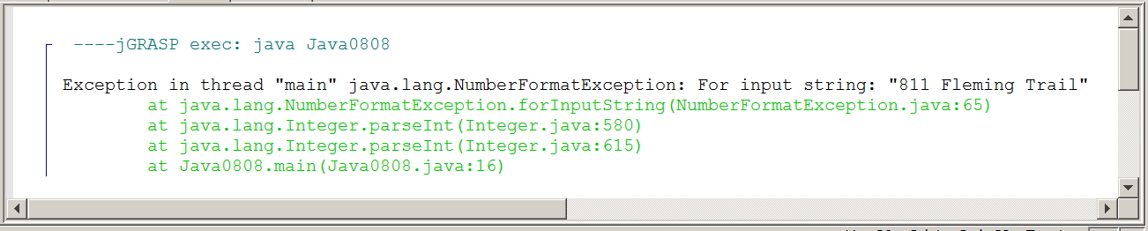
// Java0808.java
// This program converts string values to integer and double values using the
// <parseInt> and <parseDouble> methods of the <Integer> and <Double> classes.
public class Java0808
{
public static void main (String args[])
{
String s1 = "12345";
String s2 = "123.321";
String s3 = "811 Fleming Trail";
int n1 = Integer.parseInt(s1);
double n2 = Double.parseDouble(s2);
int n3 = Integer.parseInt(s3);
System.out.println(n1 + " + " + n1 + " = " + (n1 + n1));
System.out.println(n2 + " + " + n2 + " = " + (n2 + n2));
System.out.println(n3 + " + " + n3 + " = " + (n3 + n3));
}
}
Output with
comments
removed

Slide 27
Integer static method parseInt and Double static method parseDouble
int n1 = Integer.parseInt(s1);
double n2 = Double.parseDouble(s2);
Method parseInt converts a String into an int.
Method parseDouble converts a String into a double.
Parameters that include non-numerical characters will compile, but will cause a
run-time error.

Slide 28
Section 8.6
Comparing
Strings

Slide 29


// Java0809.java
// This program checks equality of strings using the == operator.
// This program has unexpected results.
import java.util.Scanner;
public class Java0809
{
public static void main (String args[])
{
Scanner input = new Scanner(System.in);
System.out.print("Enter a string ===>> ");
String s1 = input.nextLine();
String s2 = "Waltz";
String s3 = "Foxtrot";
System.out.println();
if (s1 == s2)
System.out.println(s1 + " equals " + s2);
else
System.out.println(s1 + " does not equal " + s2);
if (s1 == s3)
System.out.println(s1 + " equals " + s3);
else
System.out.println(s1 + " does not equal " + s3);
System.out.println();
}
}
Enter a string ===>> Foxtrot
Foxtrot does not equal Waltz
Foxtrot does not equal Foxtrot

Slide 30
// Java0810.java
// This program demonstrates the <equals> method, which is capable of
// testing equality of string objects correctly.
import java.util.*;
public class Java0810
{
public static void main (String args[])
{
Scanner input = new Scanner(System.in);
System.out.print("Enter a string ===>> ");
String s1 = input.nextLine();
String s2 = "Waltz";
String s3 = "Foxtrot";
System.out.println();
if (s1.equals(s2))
System.out.println(s1 + " equals " + s2);
else
System.out.println(s1 + " does not equal " + s2);
if (s1.equals(s3))
System.out.println(s1 + " equals " + s3);
else
System.out.println(s1 + " does not equals " + s3);
System.out.println();
}
}
Enter a string ===>> Foxtrot
Foxtrot does not equal Waltz
Foxtrot equals Foxtrot

Slide 31
What Is Going On? Part 1
int x = 10;
int y = 10;
int z = 20;
x
10
y
10
z
20
The equality operator == works with
primitive data types like int.
x == y x != z

Slide 32
What Is Going On? Part 2
s1
@dff6ccd
s2
@3b0eb0
s3
@18d107f
dff6ccd
Foxtrot
3b0eb0
Waltz
18d107f
Foxtrot
The equality operator == does not work with objects because
it compares the Shallow Values which are memory addresses.

Slide 33
What Is Going On? Part 3
s1
@dff6ccd
s2
@3b0eb0
s3
@18d107f
dff6ccd
Foxtrot
3b0eb0
Waltz
18d107f
Foxtrot
The equals method should be used with objects like Strings because
it compares the Deep Values which is the actual information stored.

Slide 34
The
Bottom Line
If you are comparing simple data types like 2 ints, 2 doubles, 2 chars or 2 booleans, use the == operator.
If you are comparing objects – and Strings are objects – you need to use the equals method.
The String class has its own equals method.
For other classes, you have to create your own.

Slide 35
// Java0811.java
// This program demonstrates the <compareTo> method, which returns an integer value.
// The returned value indicates which string alphabetically goes before the other.
// If the value is negative, the original string goes first.
// If the value is positive, the parameter string goes first.
// If the value is zero, both strings are equal.
public class Java0811
{
public static void main (String args[])
{
String s1 = "AARDVARK";
String s2 = "ZEBRA";
String s3 = "AARDVARK";
String s4 = "BART";
int value1 = s1.compareTo(s2);
int value2 = s1.compareTo(s3);
int value3 = s2.compareTo(s1);
int value4 = s1.compareTo(s4);
System.out.println("value1: " + value1);
System.out.println("value2: " + value2);
System.out.println("value3: " + value3);
System.out.println("value4: " + value4);
System.out.println();
}
}
value1: -25
value2: 0
value3: 25
value4: -1

Slide 36
String Methods equals and compareTo
if (s1.equals(s2))
int difference = s3.compareTo(s4);
Method equals returns true if s1 is equal
to s2, and false otherwise.
Method compareTo returns an int value
based on the difference between s3 and s4.
If the int value is 0, s3 and s4 are equal.
If the int value is negative, s3 goes before s4.
If the int value is positive, s3 goes after s4.

Slide 37
Section 8.7
Altering
Strings

Slide 38
// Java0812.java
// This program demonstrates using the <trim> method, which removes all
// white space characters at the beginning and end of a string object.
// NOTE: "White Spaces" are invisible characters like spaces and tabs.
public class Java0812
{
public static void main (String args[])
{
String s1 = "AARDVARK";
String s2 = " AARDVARK\t\t";
String s3 = s1.trim();
String s4 = s2.trim();
System.out.println("start" + s1 + "end");
System.out.println("start" + s2 + "end");
System.out.println("start" + s3 + "end");
System.out.println("start" + s4 + "end");
System.out.println();
System.out.println("s1 length: " + s1.length());
System.out.println("s2 length: " + s2.length());
System.out.println("s3 length: " + s3.length());
System.out.println("s4 length: " + s4.length());
}
}
startAARDVARKend
start AARDVARK end
startAARDVARKend
startAARDVARKend
s1 length: 8
s2 length: 15
s3 length: 8
s4 length: 8

Slide 39
String Method trim and White Space characters
"White Spaces" are invisible characters like spaces & tabs.
String s1 = "AARDVARK";
String s2 = " AARDVARK\t\t";
String s3 = s1.trim();
String s4 = s2.trim();
Method trim removes all white space characters at the beginning and end of a string object.
s1 | A | A | R | D | V | A | R | K
s2 | space | space | space | space | space | A | A | R | D | V | A | R | K | tab | tab
s3 | A | A | R | D | V | A | R | K
s4 | A | A | R | D | V | A | R | K

Slide 40
// Java0813.java
// This program demonstrates using the <toUpperCase>
// and <toLowerCase> methods.
public class Java0813
{
public static void main (String args[])
{
String s1 = "aardVARK for SALE, only $12.00!";
String s2 = "AARDvark FOR sale, ONLY $12.00!";
String s3 = s1.toUpperCase();
String s4 = s2.toLowerCase();
System.out.println(s1);
System.out.println(s2);
System.out.println(s3);
System.out.println(s4);
System.out.println();
}
}
aardVARK for SALE, only $12.00!
AARDvark FOR sale, ONLY $12.00!
AARDVARK FOR SALE, ONLY $12.00!
aardvark for sale, only $12.00!

Slide 41
String Methods toUpperCase and toLowerCase
s1 = s2.toUpperCase();
s3 = s1.toLowerCase();
Method toUpperCase returns a String where all letters are upper-case.
Method toLowerCase returns a String where all letters are lower-case.
Any characters that are not letters will be ignored by both methods and returned in their same relative String position.

Slide 42

Altering the Original String
Remember, String methods do not alter the original String object. They return an altered copy of the String object.
To alter the original String object, you need a statement that assigns the new copy back to the original object.
Examples:
s1 = s1.toUpperCase();
s2 = s2.toLowerCase();
s3 = s3.trim();
s4 = s4.substring(1,5);

Slide 43

AP® Exam Alert
Many String methods have been introduced.
Not all of these methods will be tested. Only the following methods are part of the AP® Java Subset:
compareTo equals length substring indexOf

Slide 44
Section 8.8
Adding Methods to
the Utility Library

Slide 45

// Utility.java
// This file contains useful methods that can be used by several different programs.
import java.awt.*;
import java.applet.*;
public class Utility
{
public static int random(int min, int max)
{
int range = max - min + 1;
int randomNumber = (int)(Math.random() * range) + min;
return randomNumber;
}
public static void setBackground(Graphics g, Color c)
{
g.setColor(c);
g.fillRect(0,0,1000,650);
}
public static void setRandomColor(Graphics g)
{
int red = random(0,255);
int green = random(0,255);
int blue = random(0,255);
g.setColor(new Color(red, green, blue));
}
public static void skip(int n)
{
for (int j = 1; j <= n; j++)
System.out.println();
}
public static void rightJustify(String text)
{
int len = text.length();
int numSpaces = 80 - len;
for (int j = 1; j <= numSpaces; j++)
System.out.print(" ");
System.out.println(text);
}
public static void center(String text)
{
int len = text.length();
int numSpaces = (80 - len) / 2;
for (int j = 1; j <= numSpaces; j++)
System.out.print(" ");
System.out.println(text);
}
}

Slide 46
// Java0814.java
// This program utilized the new methods added to the <Utility> class.
public class Java0814
{
public static void main (String args[])
{
Utility.skip(3);
System.out.println("Text output is left-justified by default.");
Utility.skip(4);
Utility.rightJustify("This text is right-justified.");
Utility.skip(5);
Utility.center("This text is centered.");
Utility.skip(2);
}
}

Slide 47
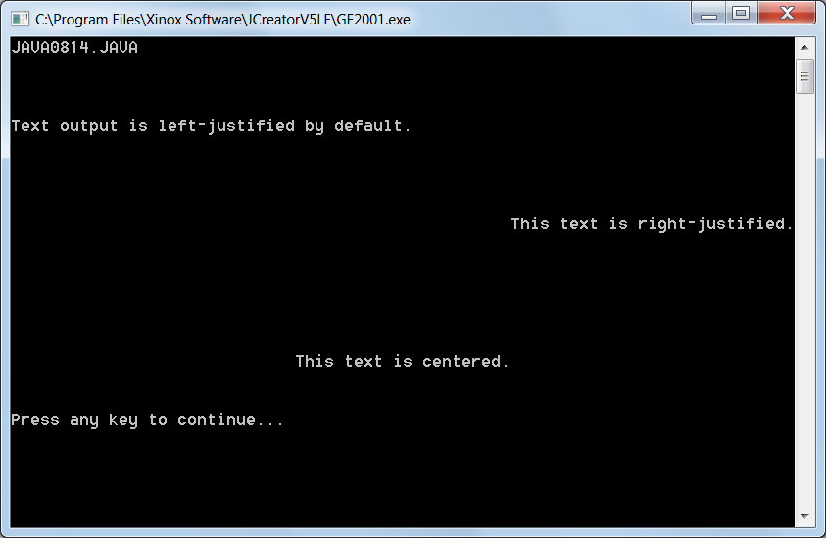

Slide 48
Section 8.9
Introduction to the
Magpie AP® Lab

Slide 49
Magpie Chatbot
Magpie is the first of 3 “AP® Labs” created by the College Board® to introduce students to key computer science programming concepts.
This specific AP® Lab is a program that simulates having a conversation with the computer by using a Chatbot program.
Each stage & sub-stage has a Magpie class file, which looks at what you type and determines the appropriate response, and a MagpieRunner class file which is the driving class.

Slide 50
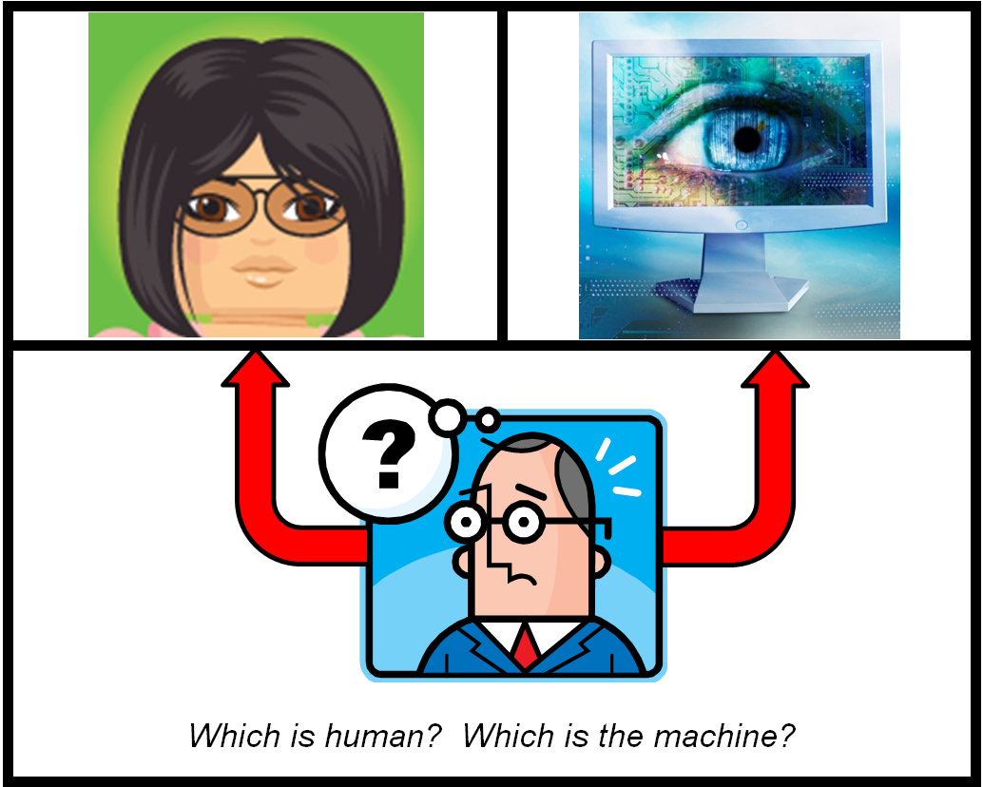
The Turing Test for Artificial Intelligence
If the interrogator cannot distinguish between the human
and the machine, it means the machine is intelligent.

Slide 51
Magpie Program Goal
The goals of the Magpie program are to give students an opportunity to use string processing and compound control structures in a program.
It is NOT the goal of this first AP® lab to create a computer program that will pass the Turing Test and achieve a considerable level of artificial intelligence.

Slide 52

So why is this a Magpie Chatbot?
Apparently, magpies chatter a lot. You may have heard the expression, “Chattering like a magpie”.
Blah, blah, blah, blah, blah, blah, blah, blah, blah, blah, blah, blah, blah, blah, blah, blah, blah, blah, blah, blah…

Slide 53
/*
* A program to carry on conversations with a human user.
* This is the initial version that:
* only provides a greeting.
* author Laurie White
* version April 2012
* Divided into stages and altered May 2014 by Leon Schram
*/
public class Magpie2a
{
public String getGreeting()
{
return "Hello, let's talk.";
}
}
/*
* A simple class to run the Magpie class.
* author Laurie White
* version April 2012
* Divided into stages and altered May 2014 by Leon Schram
*/
public class MagpieRunner2a
{
public static void main(String[] args)
{
Magpie2a maggie = new Magpie2a();
System.out.println (maggie.getGreeting());
}
}
Hello, let's talk.

Slide 54
Section 8.10
Initial Chatbot
Response

Slide 55
/*
* A simple class to run the Magpie class.
* author Laurie White
* version April 2012
* Divided into stages and altered May 2014 by Leon Schram
*/
import java.util.Scanner;
public class MagpieRunner2b
{
public static void main(String[] args)
{
Magpie2b maggie = new Magpie2b();
System.out.println (maggie.getGreeting());
Scanner in = new Scanner (System.in);
String statement = in.nextLine();
while (!statement.equals("Bye"))
{
System.out.println (maggie.getResponse(statement));
statement = in.nextLine();
}
}
}
NOTE: Starting with Stage 2B the MagpieRunner class is virtually unchanged.

Slide 56
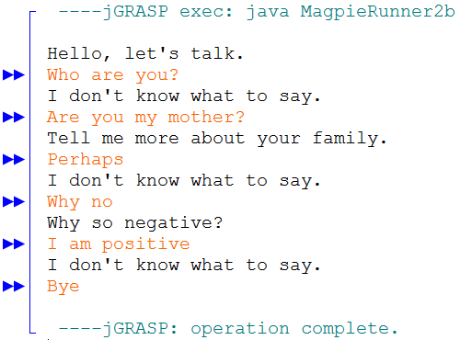
/*
* A program to carry on conversations with a human user.
* This is the initial version that:
* Uses indexOf to find strings
* Handles responding to simple words and phrases
* author Laurie White
* version April 2012
* Divided into stages and altered May 2014 by Leon Schram
*/
public class Magpie2b
{
public String getGreeting() { return "Hello, let's talk."; }
public String getResponse(String statement)
{
String response = "";
if (statement.indexOf("no") >= 0)
response = "Why so negative?";
else if (statement.indexOf("mother") >= 0 || statement.indexOf("father") >= 0
|| statement.indexOf("sister") >= 0 || statement.indexOf("brother") >= 0)
response = "Tell me more about your family.";
else
response = "I don't know what to say.";
return response;
}
}

Slide 57
Section 8.11
Chatbot Adds
Random Responses

Slide 58
/*
* A program to carry on conversations with a human user.
* This is the initial version that: *
* Uses indexOf to find strings
* Handles responding to simple words and phrases
* This version uses a nested if to handle default responses.
* author Laurie White
* version April 2012
* Divided into stages and altered May 2014 by Leon Schram
*/
public class Magpie2c
{
public String getGreeting()
{
return "Hello, let's talk.";
}
public String getResponse(String statement)
{
String response = "";
if (statement.indexOf("no") >= 0)
response = "Why so negative?";
else if (statement.indexOf("mother") >= 0 || statement.indexOf("father") >= 0
|| statement.indexOf("sister") >= 0 || statement.indexOf("brother") >= 0)
response = "Tell me more about your family.";
else
response = getRandomResponse();
return response;
}

Slide 59
private String getRandomResponse()
{
final int NUMBER_OF_RESPONSES = 4;
double r = Math.random();
int whichResponse = (int)(r * NUMBER_OF_RESPONSES);
String response = "";
if (whichResponse == 0)
{
response = "Interesting, tell me more.";
}
else if (whichResponse == 1)
{
response = "Hmmm.";
}
else if (whichResponse == 2)
{
response = "Do you really think so?";
}
else if (whichResponse == 3)
{
response = "You don't say.";
}
return response;
}
}

Slide 60
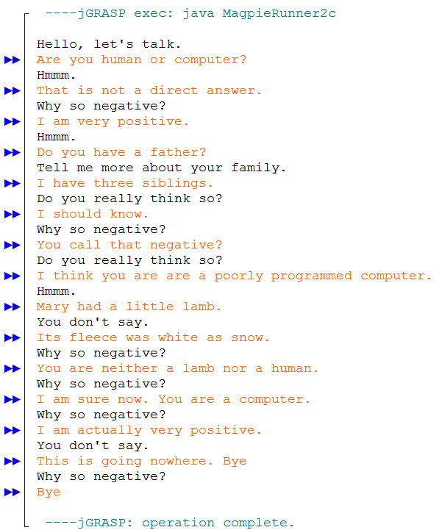

Slide 61
Section 8.12
Improving the
Negative Response

Slide 62
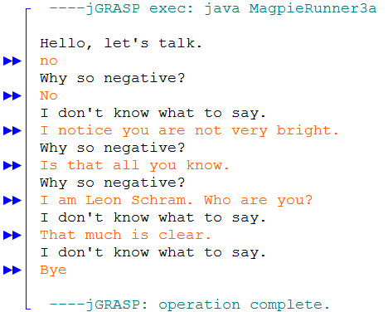
/*
* A program to carry on conversations with a human user.
* This is the initial version that:
* Uses indexOf to find strings
* Handles responding to simple words and phrases
* author Laurie White
* version April 2012
* Divided into stages and altered May 2014 by Leon Schram
*/
public class Magpie3a
{
public String getGreeting() { return "Hello, let's talk."; }
public String getResponse(String statement)
{
String response = "";
if (statement.indexOf("no") >= 0)
response = "Why so negative?";
else
response = "I don't know what to say.";
return response;
}
}
This if statement is triggered anytime statement contains the word “no”. The problem is that it is case-sensitive and it does not distinguish between “no” and words that contain “no” like “not”, “notice”, “normal”, “now”, “snow” and “know”.

Slide 63
/*
* A program to carry on conversations with a human user.
* This version starts to correct the "no" substring logic error.
* Variable psn means position.
* Magpie3b finds the word "no" in the middle of a phrase, but
* creates exception errors when "no" is at the start or end of a phrase.
****************************************************************
* author Laurie White
* version April 2012
* Divided into stages and altered July 2014 by Leon Schram
*/
public class Magpie3b
{
public String getGreeting() { return "Hello, let's talk."; }
public String getResponse(String statement)
{
String response = "";
if (findKeyword(statement, "no") >= 0)
response = "Why so negative?";
else
response = "I don't know what to say.";
return response;
}

Slide 64
private int findKeyword(String phrase, String goal)
{
phrase = phrase.trim();
phrase = phrase.toLowerCase();
goal = goal.toLowerCase();
int psn = phrase.indexOf(goal);
if (psn >= 0)
{
String before = " ";
String after = " ";
before = phrase.substring(psn - 1, psn);
after = phrase.substring(psn + goal.length(),psn + goal.length() + 1);
boolean beforeOK = before.compareTo("a") < 0 || before.compareTo("z") > 0;
boolean afterOK = after.compareTo("a") < 0 || after.compareTo("z") > 0;
if (beforeOK && afterOK)
{
return psn;
}
}
return -1;
}
}

Slide 65
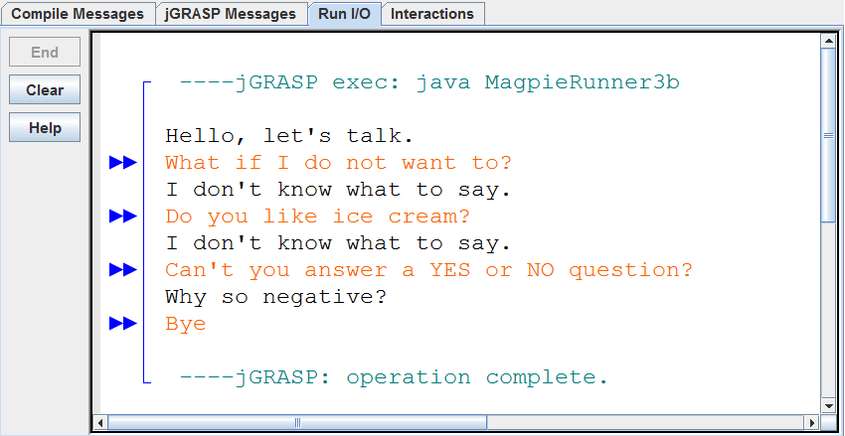
The output may give the impression that we have properly dealt with the “no” issue; however, we do need to consider 2 special cases. What if “no” is at the beginning of the statement? That would mean there is no character before it. What if “no” is at the end. Then there is no character after it.

Slide 66
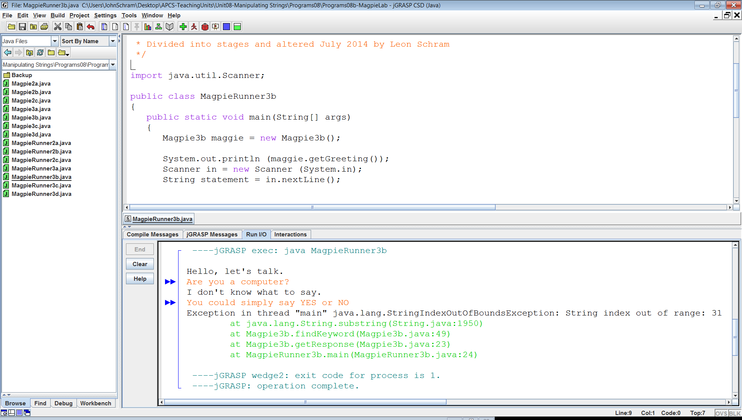
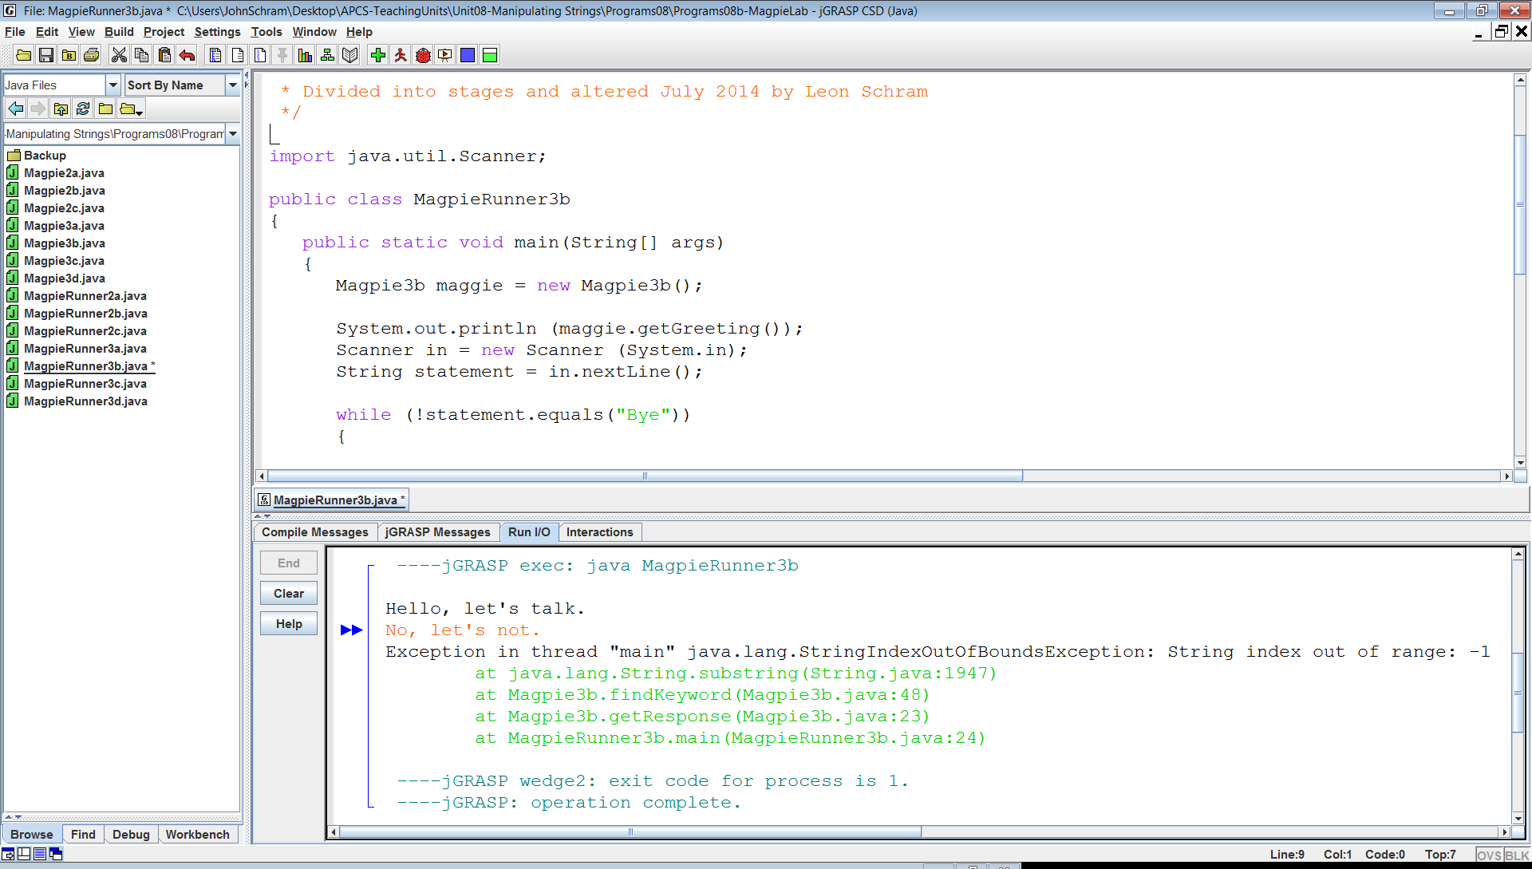
End with “no”
Begin with “no”

Slide 67
/*
* A program to carry on conversations with a human user.
* This version starts to correct the "no" substring logic error.
* Variable psn means position.
* Magpie3c finds "no" at the start, middle and end of the phrase.
* There is a problem with a phrase like "I know of no other way".
*******************************************************************
* author Laurie White
* version April 2012
* Divided into stages and altered July 2014 by Leon Schram
*/
public class Magpie3c
{
public String getGreeting() { return "Hello, let's talk."; }
public String getResponse(String statement)
{
String response = "";
if (findKeyword(statement, "no") >= 0)
response = "Why so negative?";
else
response = "I don't know what to say.";
return response;
}

Slide 68
private int findKeyword(String phrase, String goal)
{
phrase = phrase.trim().toLowerCase();
goal = goal.toLowerCase();
String before = " "; String after = " ";
int psn = phrase.indexOf(goal);
if (psn == 0) // case when "no" starts the phrase
{
after = phrase.substring(psn + goal.length(),psn + goal.length() + 1);
boolean afterOK = after.compareTo("a") < 0 || after.compareTo("z") > 0;
if (afterOK)
return psn;
}
else if (psn + goal.length() == phrase.length()) // case when "no" ends the phrase
{
before = phrase.substring(psn - 1, psn);
boolean beforeOK = before.compareTo("a") < 0 || before.compareTo("z") > 0;
if (beforeOK)
return psn;
}
if (psn > 0) // case when "no" is in the middle of the phrase
{
before = phrase.substring(psn - 1, psn);
after = phrase.substring(psn + goal.length(),psn + goal.length() + 1);
boolean beforeOK = before.compareTo("a") < 0 || before.compareTo("z") > 0;
boolean afterOK = after.compareTo("a") < 0 || after.compareTo("z") > 0;
if (beforeOK && afterOK)
return psn;
}
return -1; // case when "no" is not found
}
}

Slide 69
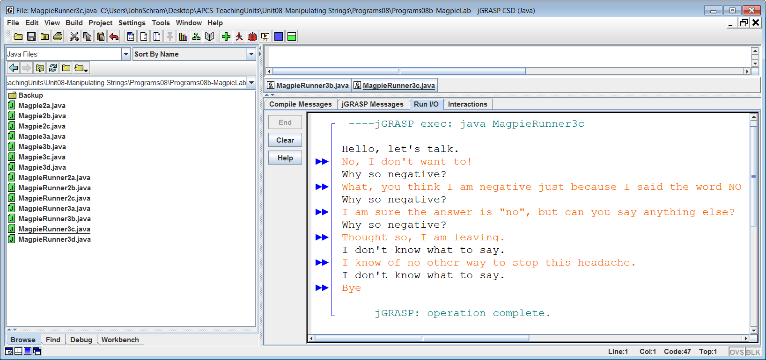
What if “no” was found, but it was part of another word like “not” or “know”? In that case we should not immediately give up because the indexOf method has only given us the location of the first instance of “no” in the string.

Slide 70
/*
* A program to carry on conversations with a human user.
* This version shows an abbreviated style of programming
* used by Laurie White in her version.
* This version also handled "I know of no way" with a loop
***********************************************************
* author Laurie White
* version April 2012
* Divided into stages and altered May 2014 by Leon Schram
*/
public class Magpie3d
{
public String getGreeting() { return "Hello, let's talk."; }
public String getResponse(String statement)
{
String response = "";
if (statement.length() == 0)
response = "Say something, please.";
else if (findKeyword(statement, "no") >= 0)
response = "Why so negative?";
else
response = "I don't know what to say.";
return response;
}

Slide 71
private int findKeyword(String statement, String goal,int startPos)
{
String phrase = statement.trim();
int psn = phrase.toLowerCase().indexOf(goal.toLowerCase(), startPos);
while (psn >= 0)
{
String before = " ", after = " ";
if (psn > 0)
{
before = phrase.substring(psn - 1, psn).toLowerCase();
}
if (psn + goal.length() < phrase.length())
{
after = phrase.substring(psn + goal.length(),psn + goal.length() + 1).toLowerCase();
}
if (((before.compareTo("a") < 0) || (before.compareTo("z") > 0))
&& ((after.compareTo("a") < 0) || (after.compareTo("z") > 0)))
{
return psn;
}
psn = phrase.indexOf(goal.toLowerCase(),psn + 1);
}
return -1;
}
private int findKeyword(String statement, String goal)
{
return findKeyword(statement, goal, 0);
}
}

Slide 72
